Slide 1
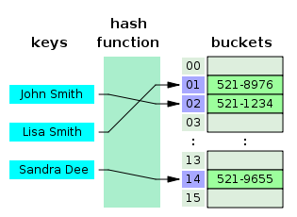
COSC 222 Data Structures
Yves Lucet
CC BY-SA 3.0 https://en.wikipedia.org/wiki/Skip_list#/media/File:Skip_list_add_element-en.gif
"Hash table 3 1 1 0 1 0 0 SP" by Jorge Stolfi - Own work. Licensed under CC BY-SA 3.0 via Commons - https://commons.wikimedia.org/wiki/File:Hash_table_3_1_1_0_1_0_0_SP.svg#/media/File:Hash_table_3_1_1_0_1_0_0_SP.svg

Slide 2
Notes:
1 Readings is to be done after Class 1 and before Class 2

Slide 3
Format
Paper only
Bring a pen or pencil
Ask for scratch paper as needed
Write answers on the answer sheet
There is limited space; it is by design
Do not
Use any cheat sheet, electronic, phone, book, etc. This is closed book
Write on the question sheet; only the answer sheet will be graded

Slide 4

Asymptotic growth
] Rank by increasing asymptotic worst-case time complexity the following functions:
$n^{3}−2 n^{2}$
$20\log{n}+4$
$n\log{n^{2}}$
n – n^{1/3}
$\sqrt{n}$
$e^{n}$
Notes:
B, E, D, C, A, F

Slide 5
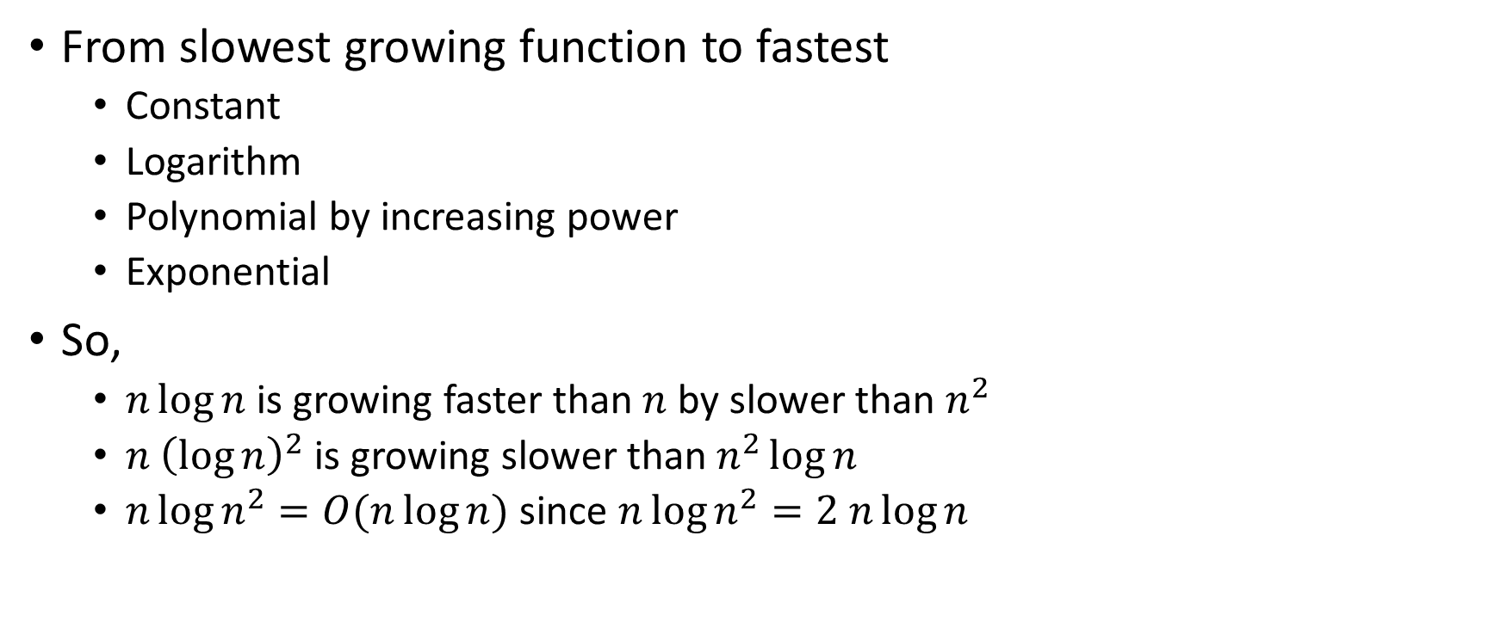
Recall
From slowest growing function to fastest
Constant
Logarithm
Polynomial by increasing power
Exponential
So,
$n\log{n}$ is growing faster than $n$ by slower than $n^{2}$
$n {\left(\log{n}\right)}^{2}$ is growing slower than $n^{2}\log{n}$
$n\log{n^{2}}=O(n\log{n})$ since $n\log{n^{2}=2 n\log{n}}$

Slide 6
Unit test
Import …
class MyClassTest {
private MyClass m;
@BeforeEach
void setUpBeforeClass() throws Exception {
this.m = new MyClass();
}
@Test
void testIsEven() {
assertTrue(m.isEven(0) & !m.isEven(1) & !m.isEven(3));
}
@Test
void testRecur_base() {
assertTrue(m.recur(0)==2);
assertTrue(m.recur(1)==3);
}
@Test
void testRecur_general() {
assertTrue(m.recur(7)==15);
}
}
public class MyClass {
public boolean isEven(int n) {
return ((n & 1) == 0);
}
int recur(int n) {
if (n==0) return 2;
if (n==1) return 3;
if (isEven(n)) return n*n;
return 2*n+1;
}
}
Testing 0, 1, 3, 7. So base case 0, 1 and default case.
But, did not test even integer.
C. appropriate, but insufficient.
Notes:
Testing 0, 1, 3, 7. So base case 0, 1 and default case. But did not test even integer.
So, appropriate, but insufficient.

Slide 7
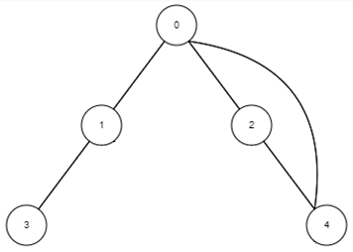
Graph representation
0->1->2->4 1->0->3 2->0->4 3->1 4->0->2
 | 0 | 1 | 2 | 3 | 4
0 |  | 1 | 1 |  | 1
1 | 1 |  |  | 1
2 | 1 |  |  |  | 1
3 |  | 1
4 | 1 |  | 1

Slide 8
Dijkstra’s algorithm
3
1
4
2
0
3
2
Start from 0
Add 2, 3 to PQ
Pick 2 at distance 2
Add 3 to PQ; now have Node 3 at distance 4, and Node 1 at distance 5
Pick 3
Pick 1
0, 2, 3, 1

Slide 9
Kruskal’s minimum spanning tree algorithm
Add edge from small to large
1, 3, 5, 6, 7
3
1
0
1
4
7
4
8
3
2
5
5
6

Slide 10
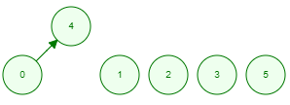
Kruskal’s minimum spanning tree algorithm
Add edge from small to large
1, 3, 5, 6, 7
3
0
1
1
4
7
0 | 1 | 2 | 3 | 4 | 5
-1 | -1 | -1 | -1 | -1 | -1
8
4
3
Add edge 1,
merge 0 and 4
0 | 1 | 2 | 3 | 4 | 5
4 | -1 | -1 | -1 | -1 | -1
2
5
5
6

Slide 11
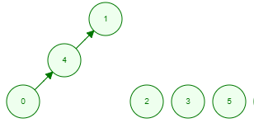
Kruskal’s minimum spanning tree algorithm
Add edge from small to large
1, 3, 5, 6, 7
3
0
1
1
4
7
8
4
3
Add edge 3,
merge 0 and 1
0 | 1 | 2 | 3 | 4 | 5
4 | -1 | -1 | -1 | 1 | -1
2
5
5
6

Slide 12

Kruskal’s minimum spanning tree algorithm
Add edge from small to large
1, 3, 5, 6, 7
3
0
1
1
4
7
8
4
3
Add edge 5,
merge 3 and 5
0 | 1 | 2 | 3 | 4 | 5
4 | -1 | -1 | 5 | 1 | -1
2
5
5
6

Slide 13
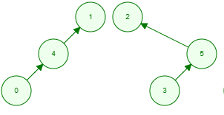
Kruskal’s minimum spanning tree algorithm
Add edge from small to large
1, 3, 5, 6, 7
3
0
1
1
4
7
8
4
3
Add edge 6,
merge 5 and 2
0 | 1 | 2 | 3 | 4 | 5
4 | -1 | -1 | 5 | 1 | 2
2
5
5
6

Slide 14

Kruskal’s minimum spanning tree algorithm
Add edge from small to large
1, 3, 5, 6, 7
3
0
1
1
4
7
8
4
3
Add edge 7,
merge 1 and 2
0 | 1 | 2 | 3 | 4 | 5
4 | 2 | -1 | 5 | 1 | 2
2
5
5
6
F.
0 | 1 | 2 | 3 | 4 | 5
4 | 2 | -1 | 5 | 1 | 2

Slide 15
Customer transactions
A company wishes to perform the following operations on its data (assume there are m transactions and n customers and n is less than m). Each transaction includes customer name, address, purchase amount, and date
Input a new transaction including customer name, address, purchase amount, and date
List the top 5 customers by total purchases made till now
List all purchases made by a customer (assume there are h purchases)
Update customer information

Slide 16
Customer transactions
Input a new transaction including customer name, address, purchase amount, and date
List the top 5 customers by total purchases made till now
List all purchases made by a customer (assume there are h purchases)
Update customer information
Need to insert/search/update on customer name, and keep track of top 5 customers

Slide 17
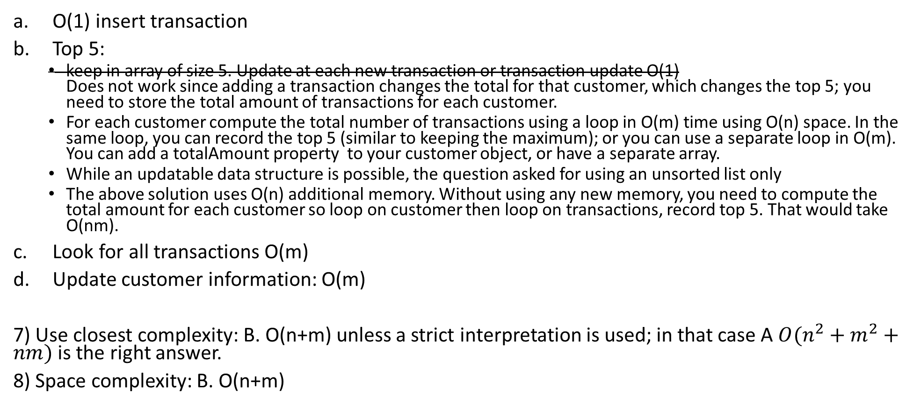
Unsorted list
O(1) insert transaction
Top 5:
keep in array of size 5. Update at each new transaction or transaction update O(1) Does not work since adding a transaction changes the total for that customer, which changes the top 5; you need to store the total amount of transactions for each customer.
For each customer compute the total number of transactions using a loop in O(m) time using O(n) space. In the same loop, you can record the top 5 (similar to keeping the maximum); or you can use a separate loop in O(m). You can add a totalAmount property to your customer object, or have a separate array.
While an updatable data structure is possible, the question asked for using an unsorted list only
The above solution uses O(n) additional memory. Without using any new memory, you need to compute the total amount for each customer so loop on customer then loop on transactions, record top 5. That would take O(nm).
Look for all transactions O(m)
Update customer information: O(m)
7) Use closest complexity: B. O(n+m) unless a strict interpretation is used; in that case A $O(n^{2}+m^{2}+nm)$ is the right answer.
8) Space complexity: B. O(n+m)

Slide 18
9) Hash table on customer name + array of size 5. Each customer has a totalAmount property, and an unsorted list of purchases
10) a. O(1) expected to insert/find in hash table then O(1) to add to list
11) b. O(1) worst-case to read top 5 transactions. Updating the top 5 is done at each insert/update in O(1)
12) c. Find customer in hash table in O(1) expected time then list all transactions in O(h) where h is the number of transactions to list
13) d. Find customer in hash table and update. In case you update the customer name, you need to remove it from the hash table and re-insert it (since the hash key is changed). Overall, O(1) expected

Slide 19
Other ideas
Instead of an array of size 5 and storing the totalAmount for each customer, one could use an updatable data structure. It is more complicated to maintain and use more memory.
Updatable priority queue with key on totalAmount.
each time a transaction is added, find the customer in the hash table, find the position in the PQ, and update the totalAmount in the PQ in O(log n).
Do 5 removeMin operations to read top 5 then re-insert them.
Updatable skip list: key is on totalAmount.
New transaction: find customer in hash table, find position in skip list, update position in O(log n)
Read top 5 from tail pointer on bottom right of skip list
Updatable balanced search tree: same idea as skip list

Slide 20
Join
You are given 2 arrays A and B of sizes n and m respectively. Array A contains pairs of objects storing a key and a value. Array B contains similar information i.e., objects with a key and an associated value. Explain an algorithm to list all the objects as key in array A, value in array A, and value in array B for which the key in array B is equal to the key in array A.

Slide 21
Join
This is a joint operation. Joints can be done as hash joints, sorting joints, or for small tables, as nested loops.
Sorting joint: Sort array A on its key, sort Array B similarly then use an index in A and an index on B. move indexA till it is above indexB then move indexB till it is above indexA, and keep going. In the end, you would scan each array once. Overall complexity is O(n log n + m log n + n + m )=O(n log n + m log m)
Hash joint: You can always assume n < m (trivial to change otherwise). Use a hash tables Hb with the keys in Array B and the value from Array B. Then for each key in A, look it up in Hb. If in there, display the value else loop; this gives a O(n) expected complexity.
Nested loops: for each element in A, for each element in B, if there is a match then display. This is the simplest solution. Although it is inefficient for large values of n and m, it is routinely used in databases for small tables. The complexity is O(nm).
In the worst case, n = m and ignoring the cost of sorting (done as pre-processing), the first two algorithms have the same O(n) query time with sorting being worst-case and hashing being expected. In practice, sorting joints are used for range queries while hash joints are used to look for specific values.

Slide 22
Format
Keep in mind:
The midterm can only benefit you!
Paper only
Bring a pen or pencil
Ask for scratch paper as needed
Write answers on the answer sheet
There is limited space; it is by design
Do not
Use any cheat sheet, electronic, phone, book, etc. This is closed book
Write on the question sheet; only the answer sheet will be graded

